Slide 1
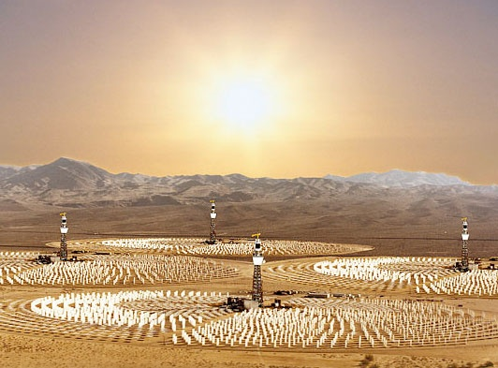

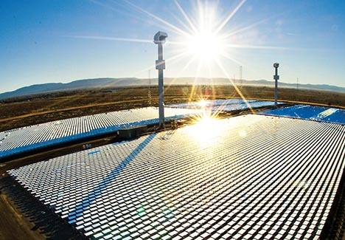

Presentation to 29th State High Level Clearance Committee
chaired by
SHRI JAGADISH SHETTAR
Hon’ble Chief Minister,
Government of Karnataka

Slide 2
Sagitaur Group
Sagitaur Group is an Entrepreneurial driven fast emerging group with interests in in sectors like Green Energy, Telecom, Information Technology and E-Governance.
Anthem India Infopoint Pvt. Ltd: Based out of Bhubaneswar, it provides the entire spectrum of e-governance services starting from basic data entry operations to high end software and e-governance applications.
TalentSprint: TalentSprint is a leader in creating skilled and certified professionals for the global industry through fast track SPRINT programs. The current focus is on the Information Technology and Banking sectors. TalentSprint’s skill development programs are designed by industry experts and backed by international certifications.
InKnowTech Pvt. Ltd. is a global IT and network infrastructure and services provider with clientele across almost all major industries and geographies. InKnowTech focus on Business Consulting, IT Services Management, Remote IT Management and Tech Support.

Slide 3
Sagitaur Solar PV Projects
Sagitaur Ventures is currently in the process of rolling out several solar projects in the states of Karnataka, Rajasthan and Orissa.
Proposed integrated Solar Park in Karnataka, which has integrated Solar Power Generation along with a small Manufacturing zone.
30 MW Solar PV Project in Rajasthan
10 MW Solar PV in Karnataka under REC Scheme
10 MW Solar PV in Orissa under REC Scheme

Slide 4
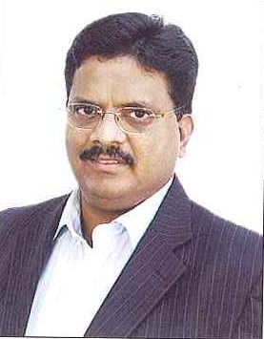
Chairman & CEO of Sagitaur Group
Mr. B V Naidu
Mr. Naidu brings over 25 years of rich experience, actively engaging with the Industry, Government Departments and Academic Institutions in creating a Techno Economic Eco System in Bangalore.
Mr. Naidu was Director Software Technology Parks of India (STPI) Bangalore/Hyderabad, Govt. of India.
Mr. Naidu has been at the fore front of building the Karnataka / Bangalore IT as a global brand. A seminal role was played by him in the growth of IT Industry in India and facilitated the growth of the software exports from less than $5 million with 13 companies to $ 11.0 billion from more than 1800 companies in Bangalore by 2007. He has Contributed extensively in all major initiatives across the country.
Prior to that he was, with Dept of IT, Govt of India and was instrumental in bringing in the first ever E-mail network, and first Internet Node into the country (ERNET)
Mr. Naidu holds a Master’s Degree in Electronics (Applied Electronics) from Madras Institute of Technology, and Bachelor's degree in Electronics & Communication, from Andhra University.
He is very proactive in the industry:
Founding trustee of the Indian Institute of Information Technology (IIIT-Bangalore)
Karnataka Chief Minister’s Task Force on IT in 2000
Former Director Karnataka IT fund
Former Chairman Indian Semiconductor
Association (ISA)
Founding Trustee of TiE (The Indus
Entrepreneur)
Chairman of the Sub committee to write the recommendations for ESDM at National level, which led to the New Electronics Policy that was announced few month back.
Vice Chairman of the “Karnataka ICT Group” which was set-up by the Chief Minister to strategize the road map for the Karnataka ICT growth for 2020

Slide 5
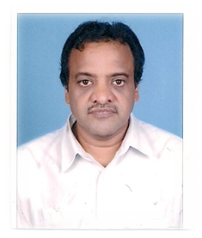
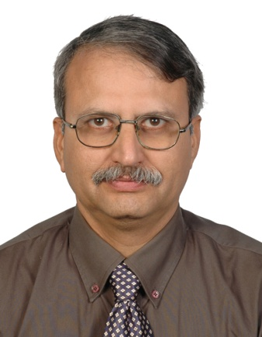

Key Founders & Management Team
Manas Patnaik Director: Sagitaur & KEZ
Director & Chief strategy officer for Techno Park, Ivory Coast, Africa
Chairman of Antham group of companies
Member technical, Supreme court of India, responsible for computerization of judiciary
Former STPI Director, Bhuvaneshwar & STPI New Delhi
Former advisor IT to President of Ivory Coast
Vittal Bhat
28 years of experience in software,animation,multiple infrastructure .
Held key positions Grasim, IMRglobal, Compudyne Winfosystems,
Global E-SoftSys, Radiant and United Telecom
He was instrumental in building state of art offshore development centre with a
team of 450.
Venkat Ravoori
Vice President:Sagitaur
25 years of experience in IT Management covering Business development, Sales
support, New Product Introduction, Global IT Delivery & Program Management
Held key positions Keane, Apple Computers Inc, Brocade Communication
Diverse background in Education, Manufacturing, Financial Services (Banking),
Telecommunications, Technology, Transportation and Pharmaceutical industries

Slide 6
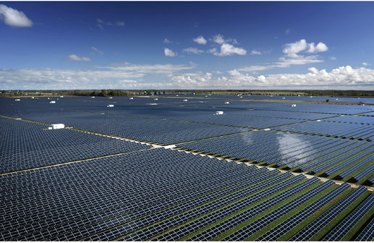
Karnataka Solar Park

Slide 7
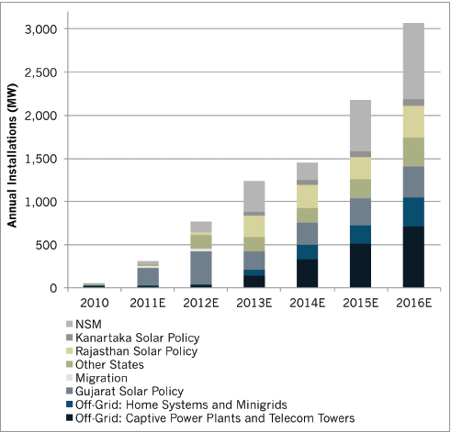
Solar Installations – Projected Growth in India

Slide 8
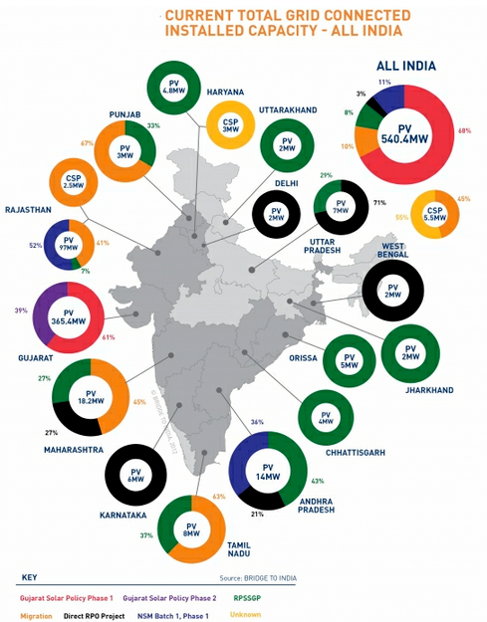
Solar Installations – Current Grid Connected

Slide 9
Solar Parks – Worldwide
There are many huge solar parks across the globe and these have been
successful. The largest photovoltaic power plants are as follows
Golmud Solar Park (China, 200 MW)
The park is located in Golmud, Qinghai Province, China. With an installed capacity of 200MW it was the largest solar park at the time of commissioning in October 2011. It is owned by the Huanghe Hydropower a subsidiary of China Power Investment Corporation and was completed by Yingli.
Perovo Solar Park (Ukraine, 100MW)
The park is located at Perovo, Crimea, Ukraine. It is owned and completed by Activ Solar in December 2011.
Sarnia Photovoltaic Power Plant (Canada, 97 MW)
The park is located near Sarnia, Ontario in Canada. At the time of completion in September 2010 it was the world’s largest photovoltaic plant. Enbridge owns the plant; it was completed and is been operated by First Solar under a long-term contract for Enbridge.

Slide 10
Solar Parks – India
Gujarat Solar Park (Charanka, 214 MW)
Presently the largest Solar Park in the world, the Gujarat Solar Park in
Charanka, Patan in the northern Gujarat is built on a 2000 ha plot.
It includes 17 different projects by different developers.
A part of it was commissioned on April 2012 under the Gujarat state policy.
Rajasthan Solar Processing Zone
100+ MW Solar project at Ramdevra.
Sagitaur’s Proposed Karnataka Solar Park
250 MW Solar project at Challekere to be built on 1200 Acres of land.

Slide 11
Karnataka Solar Park
Karnataka Solar Park
A Group Captive Solar Park for SMEs
Relevance to SMEs:
Currently Power Generation is limited to large industry houses and doesn’t provide opportunity to SMEs
Solar PV power Generation can provide the opportunities to SMEs since it is scalable in 1 MW blocks and based on the capability of SME any size can be created from 1 MW to larger size
In spite of Modular advantage of the PV technology, SMEs could not penetrate due to the bidding process coupled with high Bank Guarantees, EMD. Because of these huge barriers, solar PV has been limited to large industry groups

Slide 12
Karnataka Solar Park
Karnataka Solar Park
A Group Captive Solar Park for SMEs
The Proposal:
Sagitaur proposed to develop a “Karnataka Solar Park” which will be an integrated solar park having Solar PV Power Generation along with small Manufacturing zone focusing on the SMEs to create more entrepreneurs in this sector
Sagitaur proposed to develop the Solar Park as a “Group Captive Solar park for SME” in 1200 Acres of land. The SMEs can enjoy economies of scale of 250 MW, while participating in 1 MW and above in blocks not exceeding 3 MW and 5 MW power projects.
Sagitaur intends to bring down the Capital Cost per MW by 10-15% because of the shared common infrastructure, which is good for SMEs
Sagitaur will develop this Solar park to support 40 – 60 SMEs participation in Solar power generation, which will otherwise be difficult for SMEs to participate in because of the huge EMDs/BG in normal bid process

Slide 13
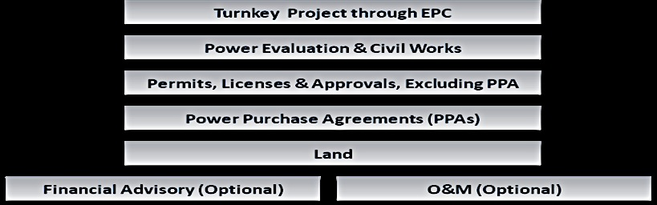
Karnataka Solar Park
Karnataka Solar Park : The Offerings

Slide 14
Karnataka Solar Park
Karnataka Solar Park
High Level financials
The project now aims to develop the 1100 acres of land at Challakere with pooling substation, power evacuation lines to the nearest grid sub-station , all other common infrastructure, proper fencing, compound wall, internal roads, access roads. The above infrastructure can cater to a generation of 250 MW of power generation.
The total project cost is given below:
Total Project Cost (Rs. In Crores)
Cost for Solar Park Development l : 58.00
Cost for 25MW Solar PV Plant : 190.00
Total Project Cost : 248.00
Project Cost for Solar Park Development (Rs. In Crores)
Land & Site Development l : 18.00
Electrical Transformers, Switch Yard & Sub station : 22.00
Fencing and Compound Wall : 6.00
Electronic Monitoring Systems : 2.00
Grid Connectivity Cost : 10.00
Total : 58.00
Means of Finance:
Debt-Equity Ratio = 80:20
Debt = 197.00 Crores
Equity = 49.00 Crores

Slide 15
Karnataka Solar Park
Karnataka Solar Park
Key Advantages for SMEs:
Size of 250 MW will drive the motivation for many of the partners:
Reduced Capex because of the economies of scale.
Availability of the Worlds best Technology/EPC partner.
Single Point for contact for financial needs “Equity and Debt Investment”
Complete Plug and Play with all the approvals including “Power Purchase Agreement (PPA)
Support of Multilateral agencies

Slide 16
Karnataka Solar Park
Karnataka Solar Park
Economic Advantages
Economic Advantages:
Sagitaur plans to develop up to 250 MW solar power plants on 1200 acres which will improve
Power availability – This will improve the current acute power shortage in the state and the country. This improves economic development by impacting manufacturing and other services
Employment Generation – Sagitaur estimates the Group Captive park to result in generating employment for 6000 to 8000 persons
Cost of power generation – Sagitaur estimates the cost of generating power will reduce by 10% to 15% due to shared infrastructure facilities provided by the Park
Manufacturing – Sagitaur’s partnership will encourage and establish local manufacturing of components required to address the solar plant construction and maintenance which will bring down the cost of power production

Slide 17

Karnataka Solar Park
Karnataka Solar Park
Key ingredients for Successful implementation
Execution Expertise:
It is headed by Stanford Phd, former CTO of Nvidia, former CEO of Sukam. Executed more than 70 MW Project in the country. Excellent Execution Track record.
PPA & Strategic Partnership:
Partnership with PTC for Anchor PPA as well for long term participation. ( Promoted by PSUs, PTC has 30000 MW of
Power PPAs with 60% market share, now promoting
Green Energy thorough Bundled power )
“ We have signed an MOU with PTC too provide a PPA for 25 MW & A letter of interest for participating in Group Captive Solar Park for full 250 MW”

Slide 18


Karnataka Solar Park
Karnataka Solar Park
Key ingredients for Successful implementation
Investment Partnership
Cirus Solar – An Engineering, Procurement and Construction company which specializes in building Solar Plants
“We have signed an MOU with Cirus Solar for 85% investment for all
250 MW of the projects in Solar Park”
OPDE Corp – An Spain based Engineering, Procurement and Construction company which specializes in building Solar Plants with more than 150MW in operation
We are in the process of signing an MOU with OPDE Corp to meet
the commitment for the Group Captive Solar Park

Slide 19


Karnataka Solar Park
Karnataka Solar Park
Key ingredients for Successful implementation
Technology Partnership
AU Optronics Corp – An $ 12 Billion Taiwan based Semi-conductor industry giant which will provide an end to end technology components & solution for solar power plants. We intend to encourage this relationship to set up manufacturing locally to support the Solar park and other domestic solar installations/developments
“We have signed an MOU with AU Optronics Corporation to meet
the commitment for the Group Captive Solar Park – Willing to bring
the investment from Japanese Multilateral agency for 250 MW ”
Canadian Solar - An NASDAQ listed Semi-conductor industry leader which will provide an technology components & solution for solar power plants. We intend to encourage this relationship to set up manufacturing locally to support the Solar park and other domestic solar installations/developments
We are in the process of signing an MOU with Canadian Solar to meet
the commitment for the Group Captive Solar Park

Slide 20
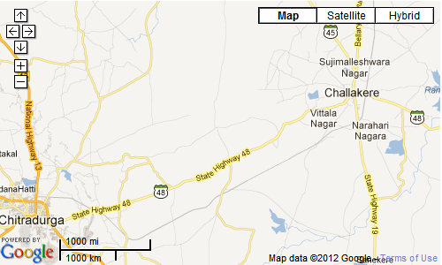
Karnataka Solar Park Location
Karnataka Solar Park Location
Karnataka Solar Park will be located in Challekere. This is in Chitradurga district in the northeastern part of Karnataka.

Slide 21
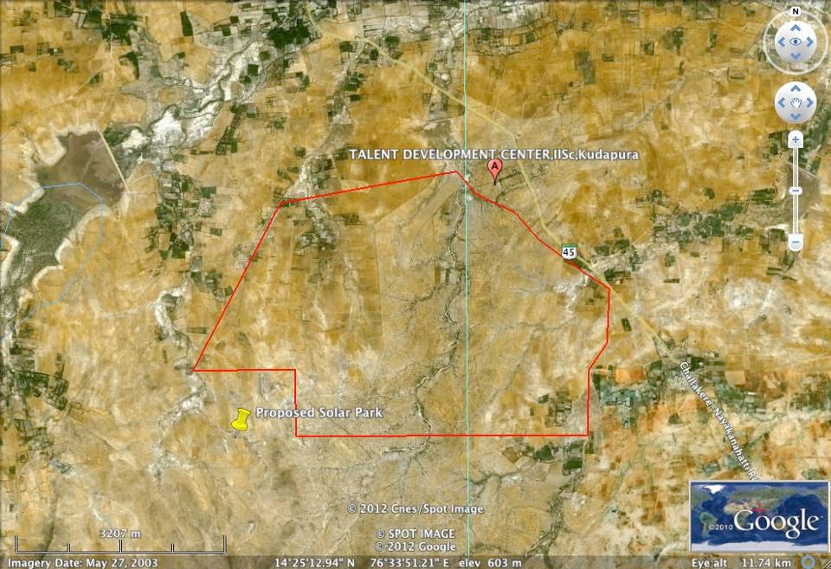
Karnataka Solar Park Location
Karnataka Solar Park Location

Slide 22
Karnataka Solar Park
Karnataka Solar Park
A Group Captive Solar Park for SMEs
Advantages of the site for the Group Captive Solar park:
Land with good exposure to Solar Radiation at par with western part of Gujarat & Rajasthan.
An innovative method to reduce the Project Cost of the Solar Power Generation, thereby reducing the unit cost of solar energy
The site has good wind availability which encourages development of a wind and solar combined power plant construction
Connectivity to grid is convenient and cost efficient due to proximity of a 400KVA
sub-station at a distance of 6 KMs from the site

Slide 23
Thank You !

